Slide 1
Classification

Slide 2
Learning Outcomes
Understand Classification
Understand Prediction
Classification issues
Classification Methods
  Bayesian classification
  Association rules
  Back-Propagation (NN)
Prediction

Slide 3
Classification vs. Prediction
Classification
  predicts categorical class labels
  classifies data (constructs a model) based on the training set and the values (class labels) in a classifying attribute and uses it to classify new data
Prediction
  Numeric prediction: models continuous-valued functions,
  Example: predicts how much a given customer will spend during sales
Typical Applications
  credit approval, target marketing
  medical diagnosis
  treatment effectiveness analysis

Slide 4
Classification
Model Construction (1st Step)
  The model should describe a set of predetermined classes
  Each tuple/sample is assumed to belong to a predefined class, as determined by the class label attribute
  The set of tuples used for model construction: training set
  The model is represented as classification rules, decision trees, or mathematical formulae
Model usage (2nd Step)
  For classifying future or unknown objects
  Estimate the model accuracy
    The known label of test sample is compared with the classified result from the model
    Accuracy rate is the percentage of test set samples that are correctly classified by the model
    Test set is independent of training set, otherwise over-fitting will occur

Slide 5
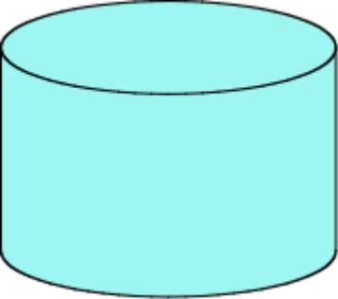
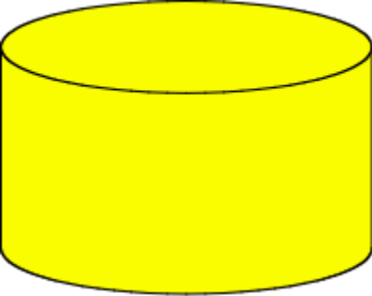
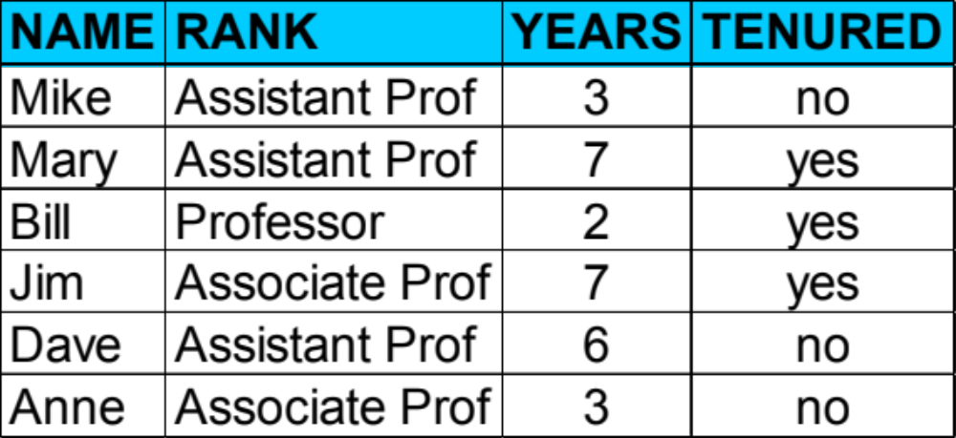
Classification Process: Model Construction
Learning
Classification
Algorithms
Training
Data
Classifier
(Model)
IF rank = ‘professor’
OR years > 6
THEN tenured = ‘yes’

Slide 6
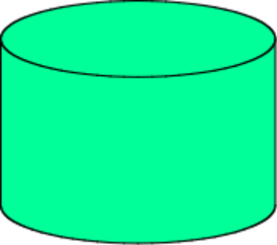
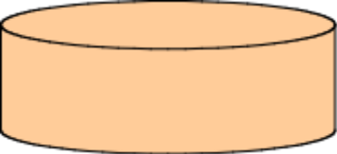
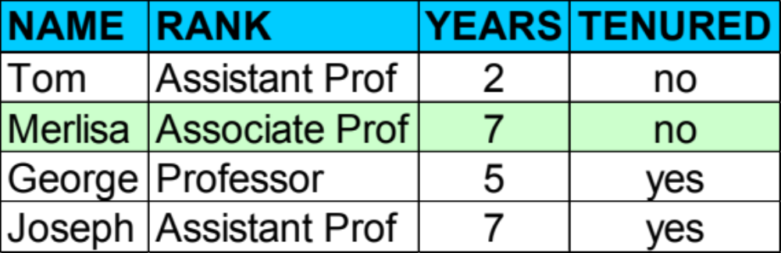

Classification Process: Use the Model in Prediction
Classifier
Testing
Data
Unseen Data
(Jeff, Professor, 4)
Tenured?

Slide 7
Supervised vs. Unsupervised Learning
Supervised learning (classification)
  Supervision: The training data (observations, measurements, etc.) are accompanied by labels indicating the class of the observations
  New data is classified based on the training set
Unsupervised learning (clustering)
  The class labels of training data are unknown
  Given a set of measurements, observations, etc. with the aim of establishing the existence of classes or clusters in the data

Slide 8
Classification Issues (1): Data Preparation
Data cleaning
  Pre-process data in order to reduce noise and handle missing values
Relevance analysis (feature selection)
  Remove the irrelevant or redundant attributes
Data transformation
  Generalise and/or normalise data

Slide 9
Issues (2): Evaluating Classification Methods
Accuracy of the prediction
Speed and scalability
  time to construct the model
  time to use the model
  efficiency in disk-resident databases
Robustness
  handling noise and missing values
Interpretability
  understanding and insight provided by the model

Slide 10
Classification by Decision Tree Induction
Decision tree
  A flow-chart-like tree structure, where
  Internal node denotes a test on an attribute
  Branch represents an outcome of the test
  Leaf nodes represent class labels or class distribution
Decision tree generation consists of two phases
  Tree construction
    At start, all the training examples are at the root
    Partition examples recursively based on selected attributes
  Tree pruning
    Identify and remove branches that reflect noise or outliers
Use of decision tree: Classifying an unknown sample
  Test the attribute values of the sample against the decision tree

Slide 11
Training Dataset
Example : Who will buy a computer?
Age | Income | Student | Credit rating | Buy computer
<=30 | high | no | fair | no
<=30 | high | no | excellent | no
31…40 | high | no | fair | yes
>40 | medium | no | fair | yes
>40 | low | yes | fair | yes
>40 | low | yes | excellent | no
31…40 | low | yes | excellent | yes
<=30 | medium | no | fair | no
<=30 | low | yes | fair | yes
>40 | medium | yes | fair | yes
<=30 | medium | yes | excellent | yes
31…40 | medium | no | excellent | yes
31…40 | high | yes | fair | yes
>40 | medium | no | excellent | no

Slide 12
Output: A Decision Tree for “buy computer”
age?
<=30
overcast
>40
30..40
student?
yes
credit rating?
no
yes
excellent
fair
no
yes
yes
no

Slide 13
Algorithm for Decision Tree Induction
Basic algorithm (a greedy algorithm)
  Tree is constructed in a top-down recursive divide-and-conquer manner
  At start, all the training examples are at the root
  Attributes are categorical (if continuous-valued, they are discretised in advance)
  Examples are partitioned recursively based on selected attributes
  Test attributes are selected on the basis of a heuristic or statistical measure (e.g., information gain)
Conditions for stopping partitioning
  All samples for a given node belong to the same class
  There are no remaining attributes for further partitioning – majority voting is employed for classifying the leaf
  There are no samples left

Slide 14
Attribute Selection Measure
Information gain
  All attributes are assumed to be categorical
  Can be modified for continuous-valued attributes
Gini index
  All attributes are assumed to be continuous-valued
  Assume there exist several possible split values for each attribute
  May need other tools, such as clustering, to get the possible split values
  Can be modified for categorical attributes

Slide 15
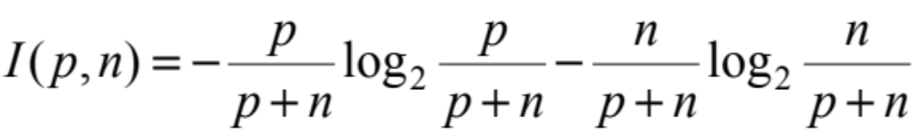
Information Gain (ID3/C4.5)
Select the attribute with the highest information gain
Assume there are two classes, P and N
  Let the set of examples S contain p elements of class P and n elements of class N
  The amount of information, needed to decide if an arbitrary example in S belongs to P or N is defined as

Slide 16
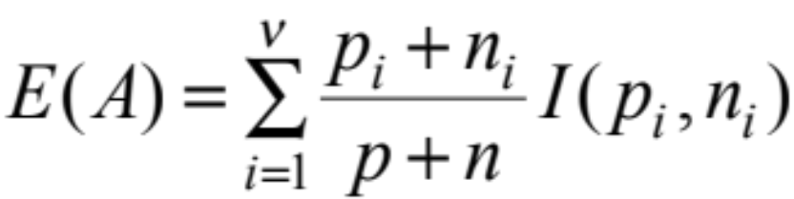
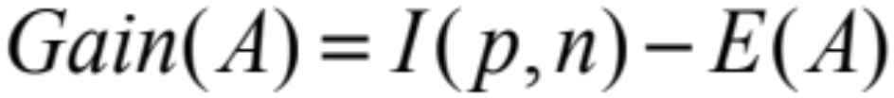
Information Gain in Decision Tree Induction
Assume that using attribute A a set S will be partitioned into sets {S₁, S₂ , …, S_{v}}
  If S_{i} contains p_{i} examples of P and n_{i} examples of N, the entropy, or the expected information needed to classify objects in all sub-trees S_{i} is
The encoding information that would be gained by branching on A

Slide 17
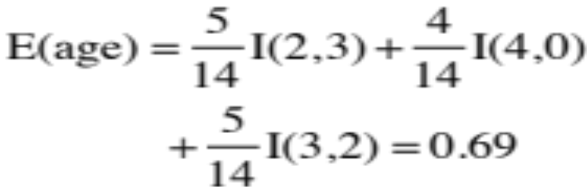

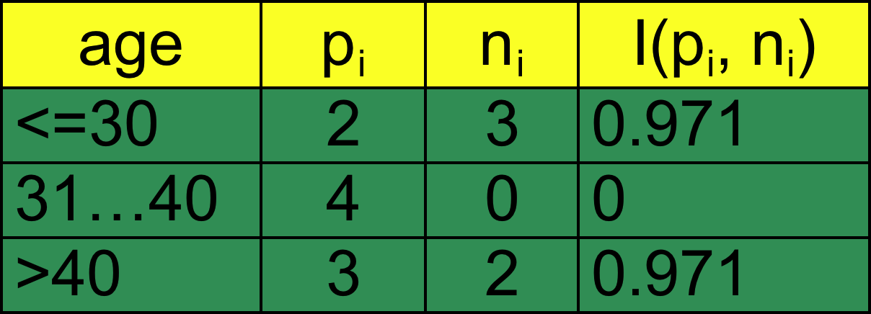
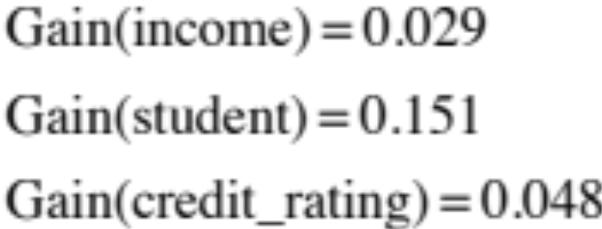
Attribute Selection by Information Gain Computation
Hence
Similarly
Class P: buys_computer = “yes”
Class N: buys_computer = “no”
I(p, n) = I(9, 5) =0.940
Compute the entropy for age:

Slide 18
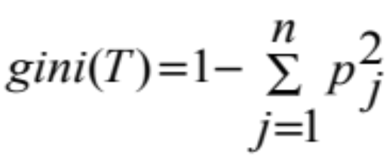
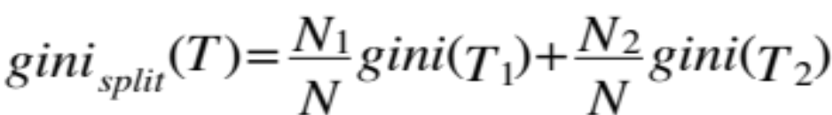
Gini Index
Gini Index
  If a data set T contains examples from n classes, gini index, gini(T) is
  Measures the impurity of the data
  where p_{j} is the relative frequency of class j in T
Gini Split
  If T is split into T₁ and T₂ of size N₁ and N₂ respectively, the gini index of the split data contains examples from n classes, and is
Attribute split
  The attribute that provides the smallest gini_{split}(T) is chosen to split the node
  (need to enumerate all possible splitting points for each attribute).
Notes:
Stopped here (11/10/2016)

Slide 19
Extracting Classification Rules from Trees
Represent the knowledge in the form of IF ()-THEN () rules
One rule is created for each path from the root to a leaf
Each attribute-value pair along a path forms a conjunction
The leaf node holds the class prediction
Rules are easier for humans to understand
Example
  IF age = “<=30” AND student = “no” THEN buys_computer = “no”
  IF age = “<=30” AND student = “yes” THEN buys_computer = “yes”
  IF age = “31…40” THEN buys_computer = “yes”
  IF age = “>40” AND credit_rating = “excellent” THEN buys_computer = “yes”
  IF age = “>40” AND credit_rating = “fair” THEN buys_computer = “no”

Slide 20
Avoid Overfitting in Classification
The generated tree may overfit the training data
  Too many branches, some may reflect anomalies due to noise or outliers
  Result in poor accuracy for unseen samples
Two approaches to avoid overfitting
  Pre-pruning: Halt tree construction early—do not split a node if this would result in the goodness measure falling below a threshold
    Difficult to choose an appropriate threshold
  Post-pruning: Remove branches from a “fully grown” tree—get a sequence of progressively pruned trees
    Use a set of data different from the training data to decide which is the “best pruned tree”

Slide 21

Determining the Final Tree Size
Separate training (2/3) and testing (1/3) sets
Use cross validation, e.g., 10-fold cross validation
Use all the data for training
  but apply a statistical test (e.g., ) to estimate whether expanding or pruning a node may improve the entire distribution
Use minimum description length (MDL) principle:
  halting growth of the tree when the encoding is minimised

Slide 22
Enhancements to basic decision tree induction
Allow continuous-valued attributes
  Dynamically define new discrete-valued attributes that partition the continuous attribute value into a discrete set of intervals
Handle missing attribute values
  Assign the most common value of the attribute
  Assign probability to each of the possible values
Attribute construction
  Create new attributes based on existing ones that are sparsely represented
  This reduces fragmentation, repetition, and replication

Slide 23
Classification in Large Datasets
Classification
  A classical problem extensively studied by statisticians and machine learning researchers
Scalability
  Classifying data sets with millions of examples and hundreds of attributes with reasonable speed
Why decision tree induction in data mining?
  relatively faster learning speed (than other classification methods)
  convertible to simple and easy to understand classification rules
  can use SQL queries for accessing databases
  comparable classification accuracy with other methods

Slide 24
Scalable DTI Methods in Data Mining
SLIQ
  builds an index for each attribute and only class list and the current attribute list reside in memory
SPRINT
  constructs an attribute list data structure
PUBLIC
  integrates tree splitting and tree pruning: stop growing the tree earlier
RainForest
  separates the scalability aspects from the criteria that determine the quality of the tree
  builds an AVC-list (attribute, value, class label)

Slide 25
Bayesian Classification
Probabilistic learning
  Calculate explicit probabilities for hypothesis, among the most practical approaches to certain types of learning problems
Incremental
  Each training example can incrementally increase/decrease the probability that a hypothesis is correct
  Prior knowledge can be combined with observed data
Probabilistic prediction
  Predict multiple hypotheses, weighted by their probabilities
Standard
  Even when Bayesian methods are computationally intractable, they can provide a standard of optimal decision making against which other methods can be measured

Slide 26
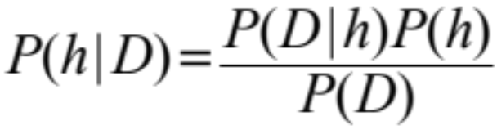
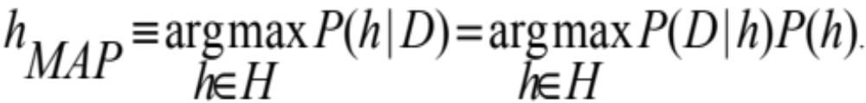
Bayesian Theorem
Posteriori Probability
  Given training data D, posteriori probability of a hypothesis h, P(h|D) follows the Bayes theorem
MAP (maximum posteriori) hypothesis
Practical difficulty
  require initial knowledge of many probabilities, significant computational cost

Slide 27
Bayes Theorem (2)
Example
  Consider a football game between two rival teams: T₀ and T₁. Suppose T₀ wins 65% of the time and T₁ wins the remaining matches. Among the games won by T₀, only 30% of them come from playing on T₁’s field. On the other hand, 75% of the victories for T₁ are obtained while playing at home.
  If T₁ is to host the next match against T₀, which team will most likely emerge as the winner?
Use Bayes Theorem
  X: random variable representing the team hosting the match
  Y: random variable representing the winner of the match
  The objective if to calculate P(Y = 1 | X = 1) or P(Y = 0 | X = 1)
Answer
  P(X,Y) = P(Y|X)*P(X) = P(X|Y)*P(Y)
  Calculate P(Y = 0), P(Y = 1), P(X = 1|Y = 1), P(X = 1|Y = 0)
  P(Y = 1|X = 1) = …
Notes:
P(X=x, Y=y) refers to the probability that variable X will take on the value x and variable Y will take on the value y.
P(X, Y) = P(Y|X) x P(X) = P(X|Y) x P(Y)
==>
P(Y|X) = P(X|Y) P(Y) / P(X)
The probability that Team 0 wins the match is P(Y = 0) = 0.65
The probability that Team 1 wins the match is P(Y = 1) = 1 - P(Y = 0) = 0.35
The probability that Team 1 hosted the match it won is P(X = 1| Y = 1) = 0.75
The probability that Team 1 hosted the match won by Team 0 is P(X = 1 | Y = 0) = 0.30
The objective is to calculate P(Y = 1 | X = 1) and compare it against P(Y = 0 | X = 1)
P(Y=1|X=1) = P(X=1|Y=1) P(Y=1) / P(X=1);
P(X =1) = P(X=1,Y=1) + P(X=1,Y=0)
= P(X=1|Y=1) P(Y=1) + P(X=1|Y=0) P(Y=0)
= 0.75 x 0.35 + 0.3 x 0.65 = 0.4575
P(Y=1|X=1) = 0.75 x 0.35 / 0.4575 = 0.5738

Slide 28
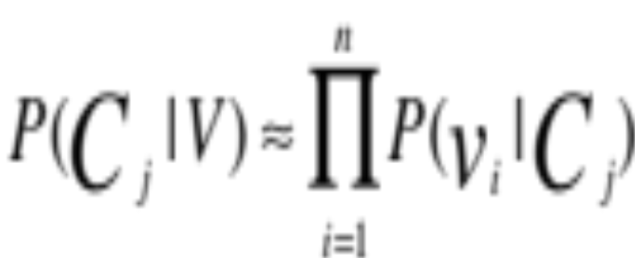
Naïve Bayes Classifier (I)
Simplified assumption
  Attributes are conditionally independent
The Cost
  Greatly reduces the computation cost, only count the class distribution

Slide 29
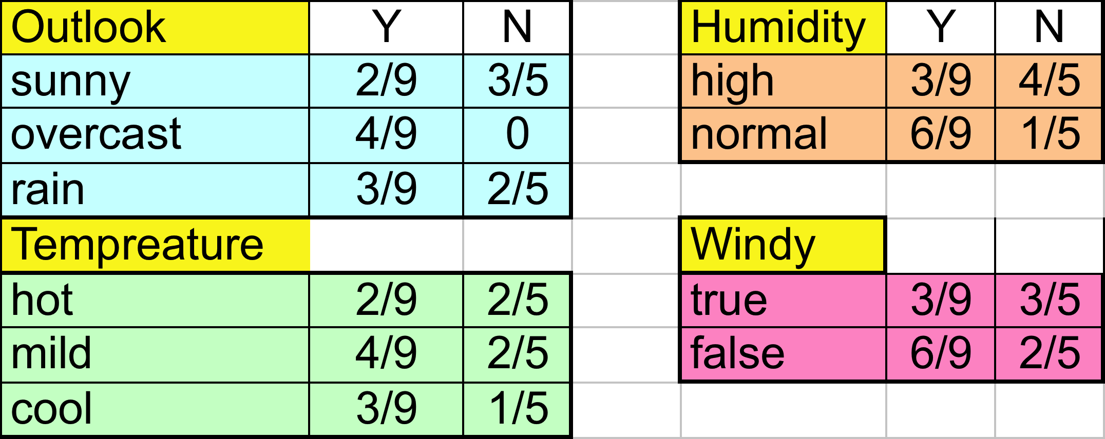
Naive Bayesian Classifier (II)
Given a training set, we can compute the probabilities

Slide 30
Bayesian classification
The classification problem may be formalised using a-posteriori probabilities
  P(C|X) = prob. that the sample tuple X = <x₁, …, x_{k}> is of class C
  E.g. P(class = N | outlook = sunny, windy = true,…)
Idea
  assign to sample X the class label C such that P(C|X) is maximal

Slide 31
Estimating a-posteriori probabilities
Bayes theorem
  P(C|X) = P(X|C)·P(C) / P(X)
  P(X) is constant for all classes
P(C) = relative frequency of class C samples
  C such that P(C|X) is maximum = C such that P(X|C)·P(C) is maximum
Problem
  computing P(X|C) is unfeasible!

Slide 32
Naïve Bayesian Classification
Naïve assumption (attribute independence)
  P(x₁,…,x_{k}|C) = P(x₁|C)·…·P(x_{k}|C)
If i-th attribute is categorical then
  P(x_{i}|C) is estimated as the relative frequency of samples having value x_{i} as i-th attribute in class C
If i-th attribute is continuous then
  P(x_{i}|C) is estimated through a Gaussian density function
Computationally easy in both cases

Slide 33
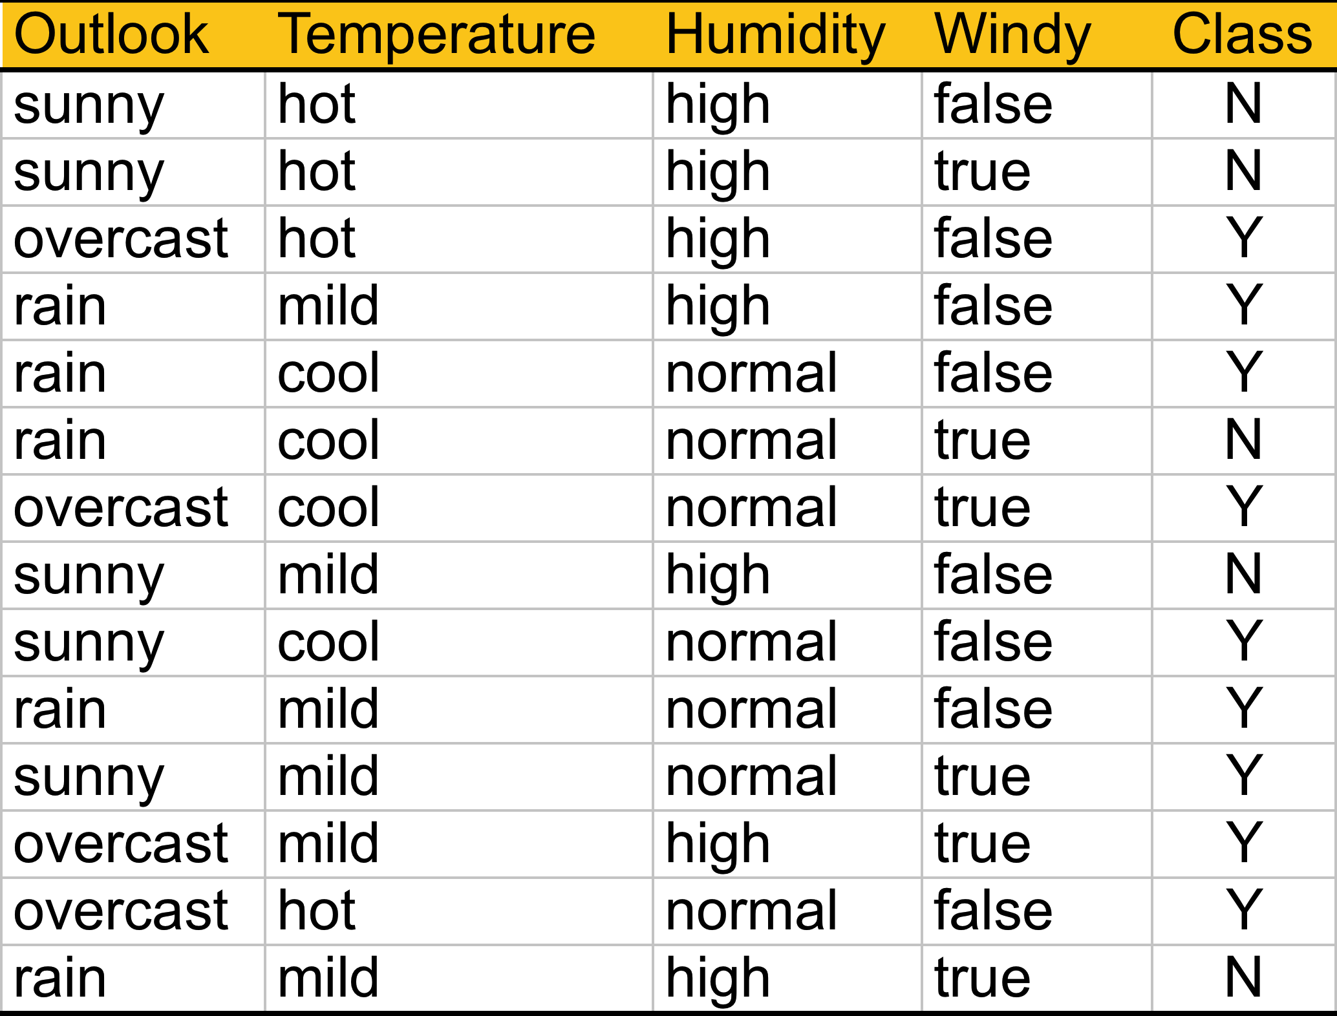
Play-tennis example: estimating P(x_{i}|C)
outlook
P(sunny|y) = 2/9 | P(sunny|n) = 3/5
P(overcast|y) = 4/9 | P(overcast|n) = 0
P(rain|y) = 3/9 | P(rain|n) = 2/5
temperature
P(hot|y) = 2/9 | P(hot|n) = 2/5
P(mild|y) = 4/9 | P(mild|n) = 2/5
P(cool|y) = 3/9 | P(cool|n) = 1/5
humidity
P(high|y) = 3/9 | P(high|n) = 4/5
P(normal|y) = 6/9 | P(normal|n) = 2/5
windy
P(true|y) = 3/9 | P(true|n) = 3/5
P(false|y) = 6/9 | P(false|n) = 2/5
P(y) = 9/14
P(n) = 5/14

Slide 34
Play-Tennis example: classifying X
An unseen sample X = < rain, hot, high, false >
  P(X|y)·P(y) = P(rain|y)·P(hot|y)·P(high|y)·P(false|y)·P(y)
  = 3/9·2/9·3/9·6/9·9/14 = 0.010582
  P(X|n)·P(n) =
  P(rain|n)·P(hot|n)·P(high|n)·P(false|n)·P(n) =
  2/5·2/5·4/5·2/5·5/14 = 0.018286
Sample X is classified in class n (don’t play)

